Slide 1

Crowd-Integrated Intelligent Traffic Management System (CITMS) 🚦
School of Computer Science and Engineering
Department of Computer Science and Engineering
Submitted By:
Shourya Vijayvargiya
2427030727
Supervised By:
Dr. Shishir Singh Chauhan

Slide 2
Outline
Introduction
Literature Review
Problem Statement
Proposed Solution
Objectives
Results

Slide 3
Introduction
Urban traffic congestion and delayed response to on-road incidents are persistent challenges in modern cities.
Conventional traffic systems rely primarily on fixed sensors, cameras, and static signal timings, limiting their ability to adapt quickly to dynamic real-world events such as accidents, emergencies, and unexpected congestion.
The proposed system introduces a Crowd-Integrated Intelligent Traffic Management System (CITMS) where road users act as real-time information sources.
Through a simple one-tap mobile interface, users can instantly report traffic conditions, enabling faster incident awareness and adaptive traffic control decisions.

Slide 4
Literature Review
Recent research (2020–2025) emphasizes AI-based traffic prediction using deep learning and graph neural networks:
• AGCRN — Adaptive Graph Learning
• GMAN — Graph Multi-Attention Mechanisms
• MTGNN — Multivariate Time-Series Forecasting
• MD-GCN — Multi-Scale Temporal Modeling
These models improve traffic forecasting accuracy.

Slide 5
Literature Review — Limitations of Existing Approaches
Despite strong prediction performance, existing systems exhibit key limitations:
❌ Heavy reliance on sensor-rich infrastructure
❌ High deployment and maintenance cost
❌ Limited awareness of sudden real-world incidents
❌ Lack of human-assisted intelligence

Slide 6
Literature Review — Research Gap & Motivation
Although recent AI-based traffic forecasting models achieve strong prediction accuracy, they primarily rely on sensor-generated datasets and focus mainly on congestion estimation rather than real-world incident awareness.
Most existing systems lack mechanisms to rapidly capture unexpected traffic disruptions such as accidents, signal failures, emergency vehicle movement, and temporary roadblocks.
Furthermore, limited incorporation of human-generated real-time inputs restricts the responsiveness of traditional intelligent traffic management frameworks.
This highlights the need for a crowd-assisted, incident-aware traffic control approach capable of improving adaptability and decision-making in dynamic urban environments.

Slide 7
Problem Statement
Despite advancements in AI-based traffic prediction and sensor-driven traffic systems, conventional traffic management frameworks struggle to rapidly detect and respond to unexpected real-world incidents.
Most systems depend heavily on fixed infrastructure such as cameras and sensors, which may introduce delays, increase deployment costs, and limit adaptability in dynamic urban environments.
There is a need for a more responsive and cost-effective mechanism that can enhance situational awareness and enable faster traffic control decisions.

Slide 8
Objectives
The primary objectives of the proposed system are:
• To design a crowd-integrated traffic reporting mechanism enabling real-time human input
• To improve traffic signal responsiveness using adaptive decision logic
• To enhance emergency vehicle prioritization and incident handling
• To reduce congestion impact through dynamic control strategies

Slide 9
Proposed Methodology (System Concept)
The Crowd-Integrated Intelligent Traffic Management System (CITMS) introduces a hybrid traffic control framework where road users act as distributed real-time information sources.
Instead of relying solely on automated sensing infrastructure, the system incorporates human-generated reports collected through a simple one-tap mobile interface.
This approach allows the traffic management system to capture dynamic traffic disruptions directly from on-ground participants.

Slide 10
Proposed Methodology (Event-Aware Reporting)
The system enables event-specific reporting of traffic conditions, including:
🚧 Road Accident
🚦 Broken Signal
🚑 Emergency Vehicle
🛑 Heavy Traffic Jam
🚫 Road Blocked
Unlike density-only approaches, this mechanism allows the system to understand the nature of traffic disruptions, enabling more targeted and context-aware control decisions.

Slide 11
Proposed Methodology (Decision Engine Logic)
Validated crowd reports update key traffic state variables:
• Traffic Density
• Queue Length
• Incident Risk
• Environmental Factors
A rule-based and AI-inspired decision engine evaluates the traffic state and selects adaptive signal control actions to improve flow efficiency and safety.

Slide 12
Proposed Methodology (Simulation & Validation)
To demonstrate feasibility of the control mechanism, the backend decision engine is modeled through a modular simulation implemented in C programming.
The simulation captures:
✔ Traffic State Representation
✔ Agent-Based Action Selection
✔ Reward-Based Evaluation
✔ Adaptive Behaviour Modeling
This validates the conceptual traffic control logic without requiring physical deployment.

Slide 13
Results
Simulation-based evaluation indicates:
• Stable adaptive behaviour across dynamic traffic scenarios
• Decision logic responds to congestion and incident variations
• Reward function penalizes inefficient and unsafe states
• Feasibility of crowd-influenced traffic control mechanisms

Slide 14
Outcome / Academic Progress
Current Semester Achievements:
✔ System framework & architecture defined
✔ Crowd-integration model designed
✔ Backend decision logic simulated in C
✔ One-tap mobile interface prototype designed in Figma
Research Paper: Planned / Draft Stage
Patent Feasibility: Under Conceptual Review
Deployment Level: Simulation / Prototype Validation

Slide 15
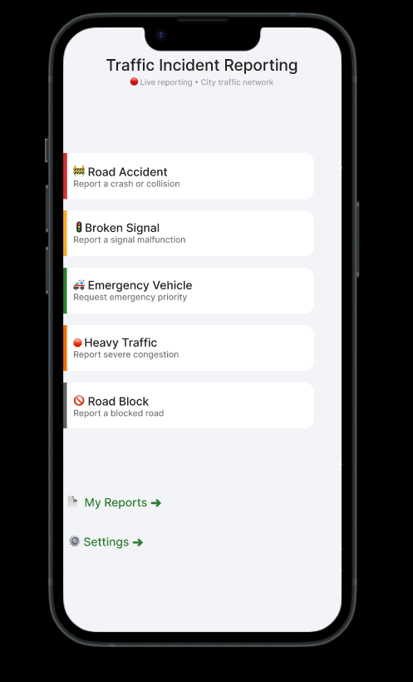
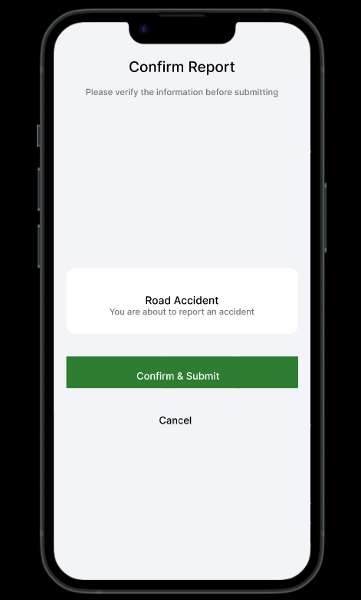
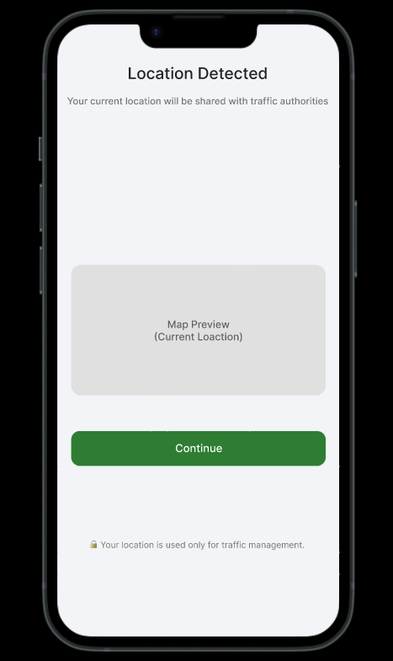
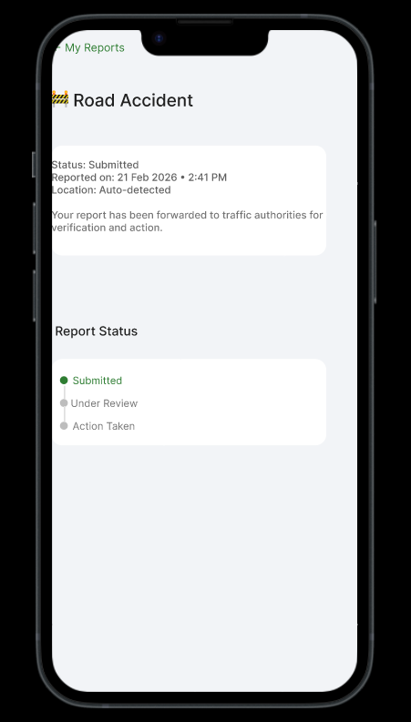
Prototype Demonstration (Figma)
View Interactive Prototype: https://www.figma.com/proto/440OMCFLPOx4NU08z3O2s0/Untitled?node-id=0-1&t=KWBO4JE2u1f2KYgx-1

Slide 16
References
AGCRN — NeurIPS 2020
GMAN — AAAI 2020
MTGNN — KDD 2020
MD-GCN — Recent Traffic Forecasting Research
Recent AI-based Traffic Management Literature (2020–2025)

Slide 17
Thank You

